Slide 1
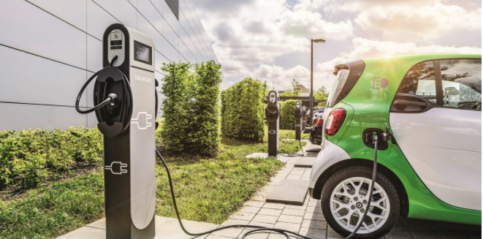
Applied Data Science Capstone Project
Electrical Vehicle Charging Stations in Paris

Slide 2
Introduction
An electric vehicle charging station, also called EV charging station is a machine that supplies electric energy for the recharging of plug-in electric vehicles
Some electric vehicles have converters on board that plug into a standard electrical outlet or a high-capacity appliance outlet. Others use a charging station that provides electrical conversion, monitoring, or safety functionality. These stations can support faster charging at higher voltages and currents
Public charging stations are typically on-street facilities provided by electric utility companies or located at retail shopping centers, restaurants, and parking places. They can be operated by various private companies

Slide 3
Business understanding
Our client is a private company which wants to invest on charging stations for electrical vehicles. The company choose Paris for their investments. The stakeholders want to investigate the city to choose the right places where they can set their new charging stations
So, the questions that we are intended to answer are:
Are there sufficient customers that have electrical vehicles in Paris ?
Can we predict the number of electrical vehicles in the future years ?
What are the places in the city that have not sufficient charging stations ?

Slide 4
Data

Slide 5
Analytic approach
We will start answering the two first questions (Are there sufficient customers that have electrical vehicles in Paris ? and Can we predict the number of electrical vehicles in the future years ?) by exploring the tables of the web sites described in the Data section and try to set a model to predict the number of electrical cars for the future years.
After we will use the foursquare API to cluster the neighborhoods in function of the existing Electrical charging stations in the venues of each neighborhood to answer the last question (What are the places in the city that have not sufficient charging stations ?)

Slide 6
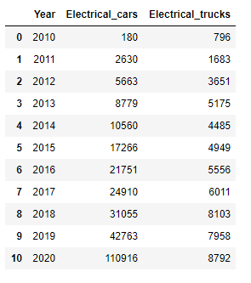
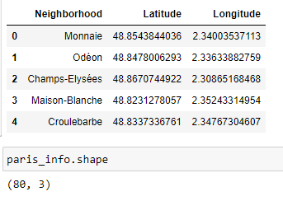
Data wrangling
We used Web Scraping to extract the table of the number of electrical cars and trucks in function of the last 10 years. We obtained the following data frame after cleaning and converting data
We used the “read_csv” method to read the csv file for the coordinates of the neighborhoods of Paris. After wrangling data, we obtained the following data frame

Slide 7
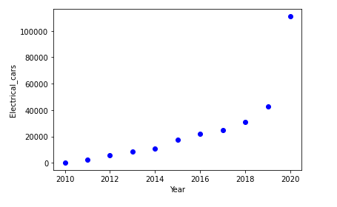
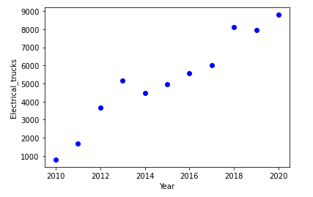
Data analysis (1)
We wanted to see if there is any correlation between the 10 years and the number of electrical cars and trucks. We found that there is a positive correlation between them

Slide 8
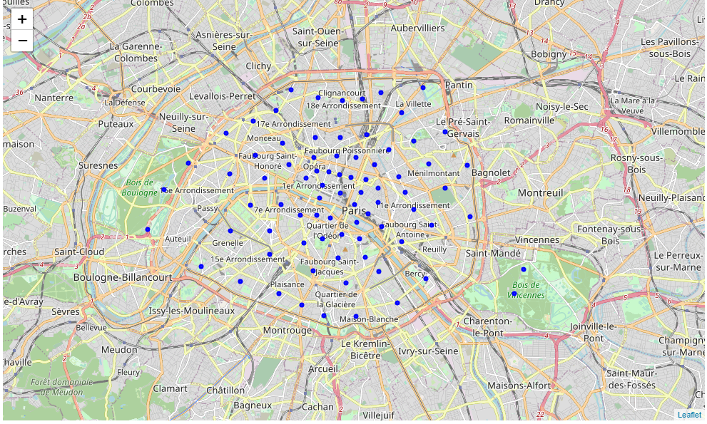
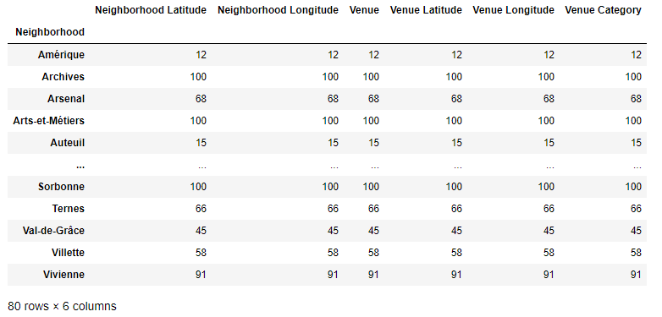
Data analysis (2)
We created the map of Neighborhoods of Paris using Folium library and the data frame containing the latitude and longitude
We can see that we have all the 80 neighborhood that we will analyses their venues with the Foursquare API by grouping these neighborhoods by venue’s categories

Slide 9
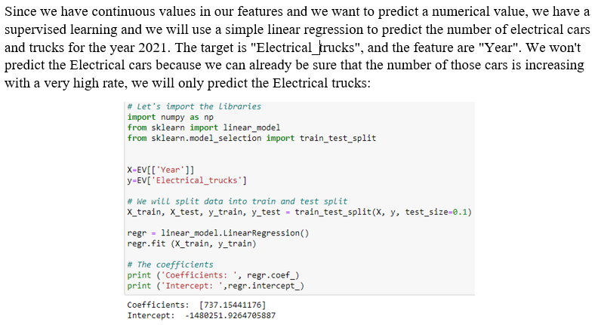
Modeling (1)

Slide 10
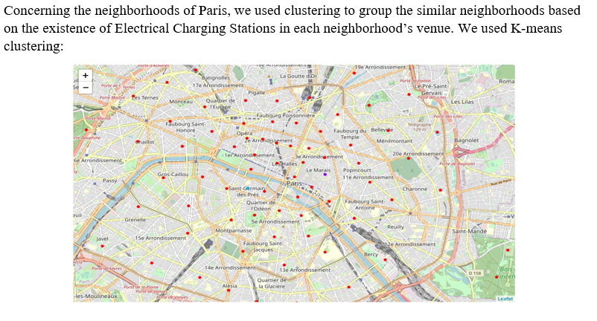
Modeling (2)

Slide 11
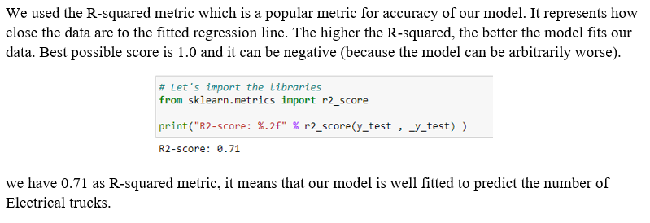
Model evaluation

Slide 12
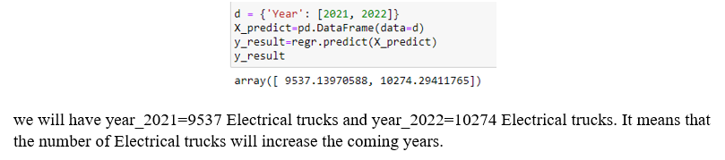
Model deployment

Slide 13
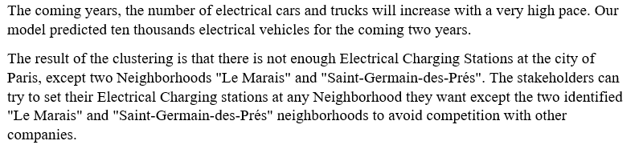
Results

Slide 14
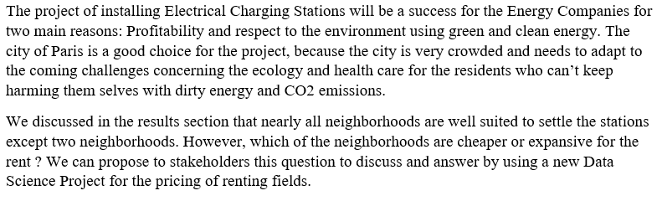
Conclusion

